Slide 1
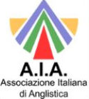
Navigating the hybrid landscape: constructing meaning through an integrated model of Intralingual Translation
AIA PhD Seminar – 6 February 2025
Michela Canepari
michela.canepari@unipr.it

Slide 2
Outline
Definition of ‘hybrid text’
Discussion of The Time Machine by H.G. Wells (1895) and some of its translations
Examination of the categories of intralingual translation
Concluisve remarks on INTRA
References

Slide 3
Korning Zethsen(2009)
“we need much more empirically-based research to provide a thorough and comprehensive description of intralingual translation”

Slide 4

For a definition of ‘hybrid text’
‘A blended or mixed-genre text’ (Elster & Hanauer, 2002)
‘A multigenre text’ (Flurkey & Goodman, 2004),
‘A single text which integrates narrative and informational text’ (Donovan & Smolkin, 2002),
‘A text that presents information about a specific topic using narrative text as the primary means of expression’ (Maloch & Bomer, 2013).

Slide 5
Rosenblatt (1994)
Reader’s Response to hybrid texts
Rosenblatt (1994)
Aesthetic
Efferent

Slide 6


The Time Machine as a hybrid text
Science Fiction
Epistemological
Ontological

Slide 7
From the ontological and epistemological to the ideological, the political and the ecological
Science fiction allows the reader to transcend the limits imposed by realism as a mode of writing, thus overflowing the boundaries not only of the text but also of reality itself, as it creates different, albeit structured and functional, societies through language, thus demonstrating the viability of realities other than those imposed by the system (Harrison, 1991).

Slide 8
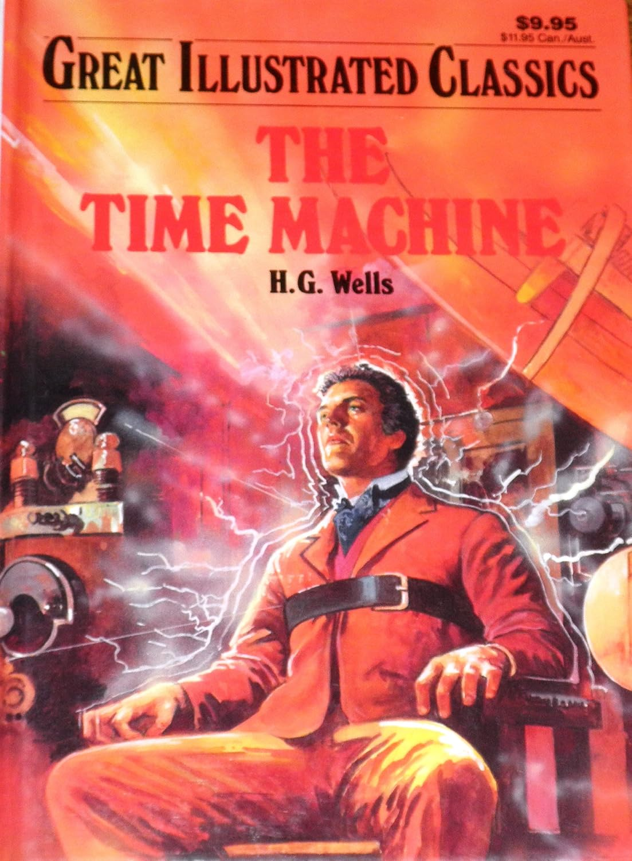
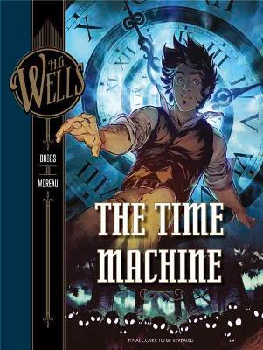
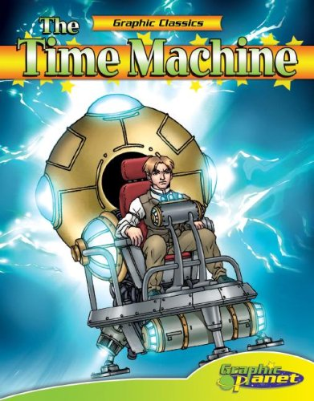
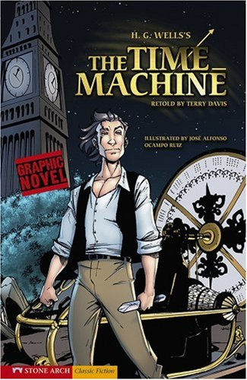
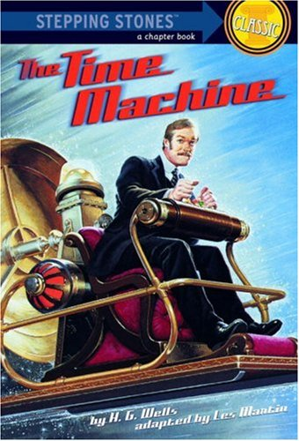
Hybrid texts
2002, Spotlight
2018, Insight Editions
2007, Graphic Planet
2007, Stone Arch Books
2005, Random House

Slide 9
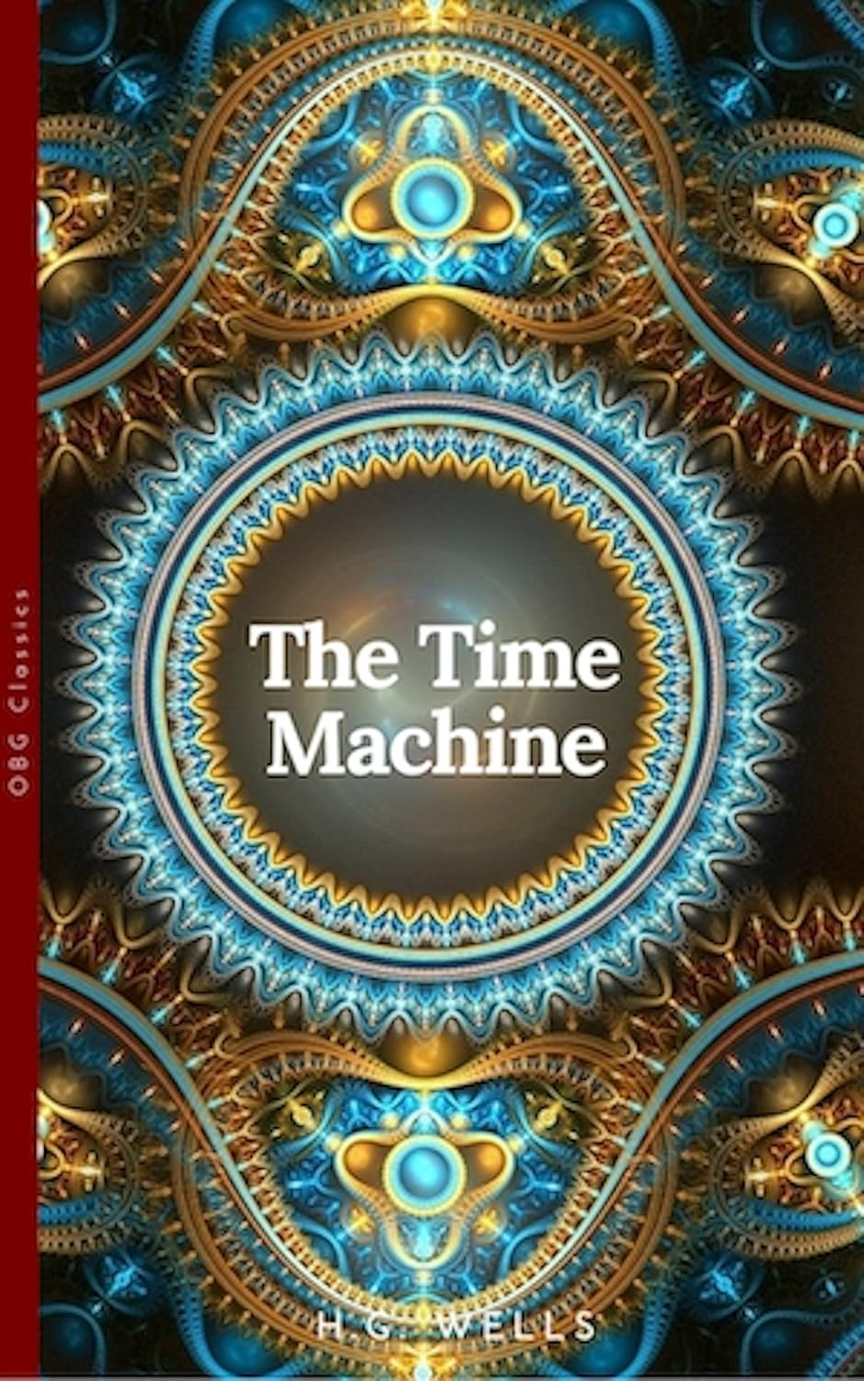
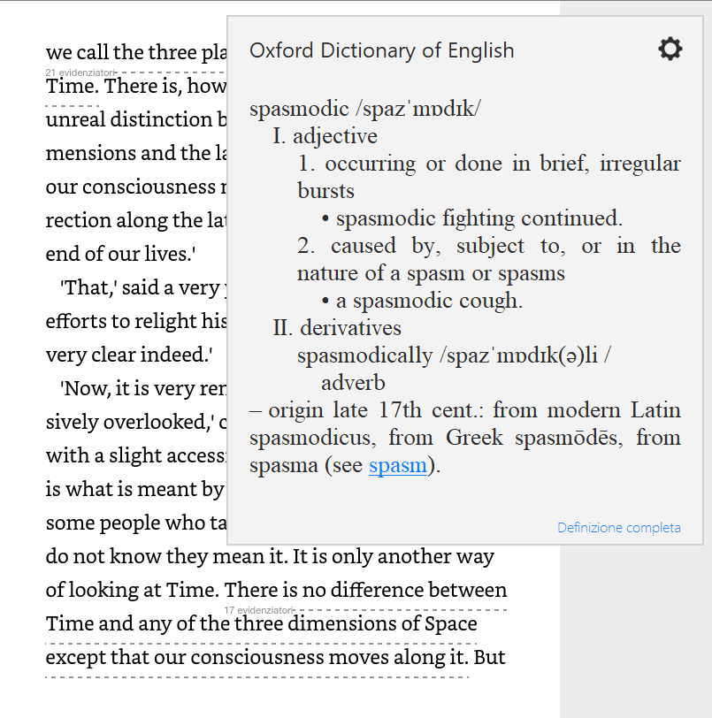
Penguin, 2019

Slide 10
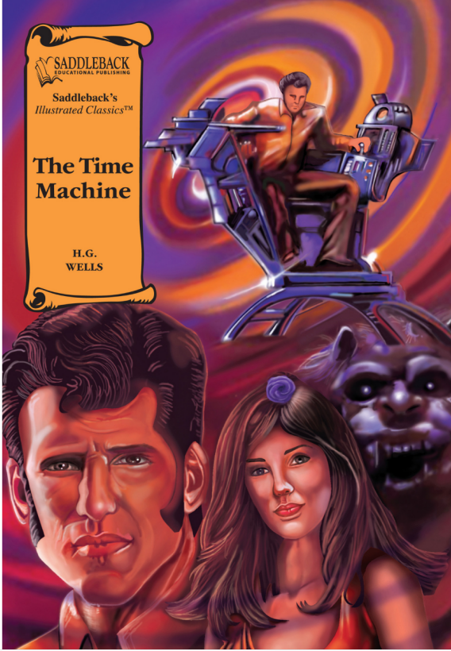
Intersemiotic translation
2006, Saddleback

Slide 11
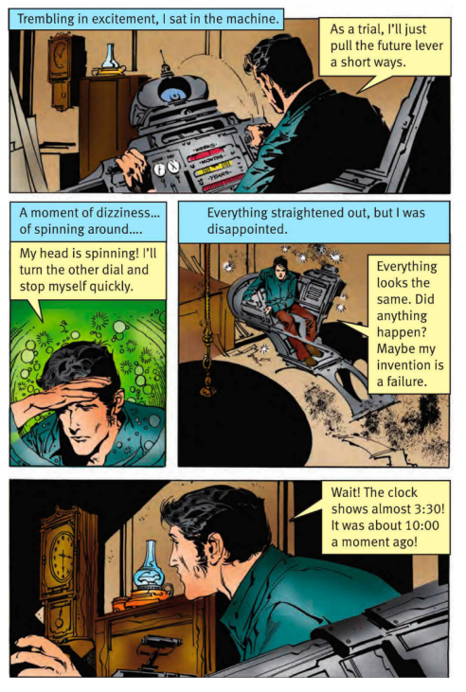
Accessibility

Slide 12
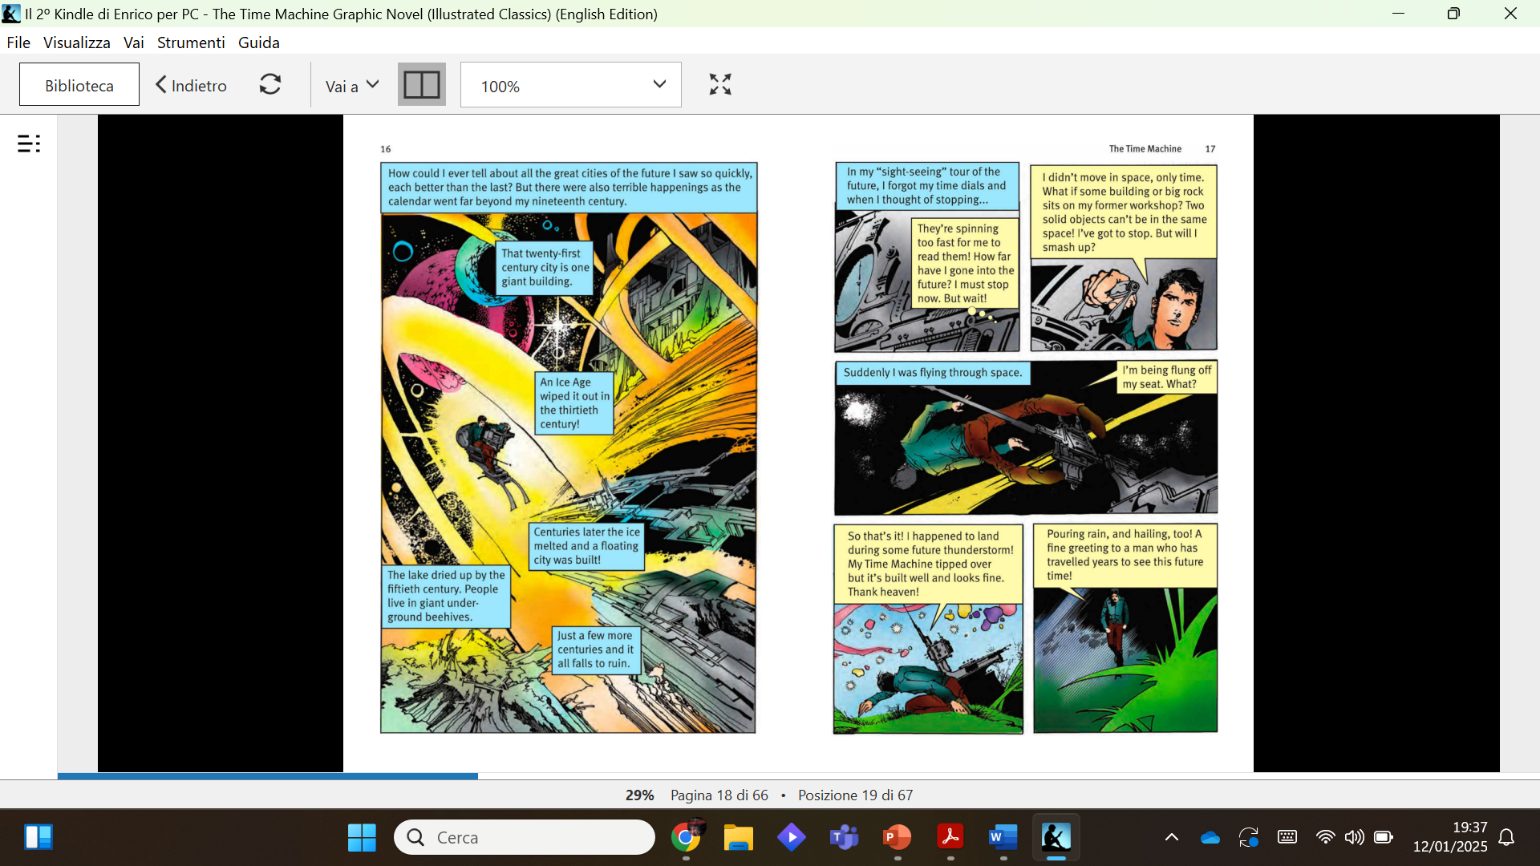
Intralingual translation
‘In the intermittent darknesses, I saw the moon spinning swiftly through her quarters from new to full and had a faint glimpse of the circling stars. Presently, as I went on, still gaining velocity, the palpitation of night and day merged into one continuous greyness; the sky took on a wonderful deepness of blue, a splendid luminous color like that of early twilight; the jerking sun became a streak of fire, a brilliant arch, in space; the moon a fainter fluctuating band; and I could see nothing of the stars, save now and then a brighter circle flickering in the blue. ‘The landscape was misty and vague. I was still on the hill-side upon which this house now stands, and the shoulder rose above me grey and dim. I saw trees growing and changing like puffs of vapour, now brown, now green; they grew, spread, shivered, and passed away. I saw huge buildings rise up faint and fair, and pass like dreams. The whole surface of the earth seemed changed—melting and flowing under my eyes’ (Wells, 1995: 24-25).

Slide 13
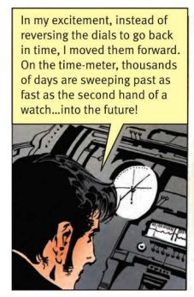
‘Now, instead of reversing the levers, I had pulled them over so as to go forward with them, and when I came to look at these indicators I found that the thousands hand was sweeping round as fast as the seconds hand of a watch—into futurity.’ (Wells, 1995: 105)

Slide 14
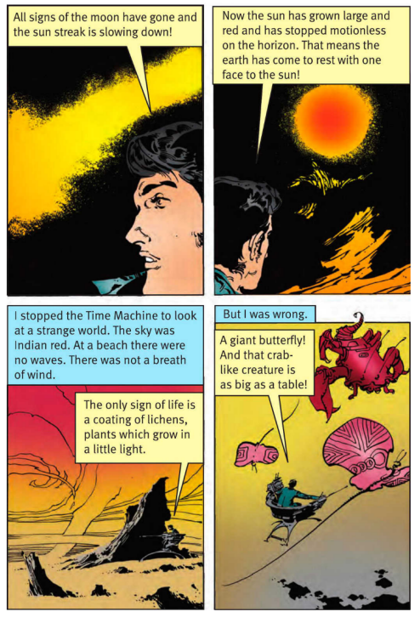
‘As I drove on, a peculiar change crept over the appearance of things. The palpitating greyness grew darker; then—though I was still travelling with prodigious velocity—the blinking succession of day and night, which was usually indicative of a slower pace, returned, and grew more and more marked. This puzzled me very much at first. The alternations of night and day grew slower and slower, and so did the passage of the sun across the sky, until they seemed to stretch through centuries. At last a steady twilight brooded over the earth, a twilight only broken now and then when a comet glared across the darkling sky. The band of light that had indicated the sun had long since disappeared; for the sun had ceased to set—it simply rose and fell in the west, and grew ever broader and more red. All trace of the moon had vanished. The circling of the stars, growing slower and slower, had given place to creeping points of light. At last, some time before I stopped, the sun, red and very large, halted motionless upon the horizon, a vast dome glowing with a dull heat, and now and then suffering a momentary extinction. At one time it had for a little while glowed more brilliantly again, but it speedily reverted to its sullen red heat. I perceived by this slowing down of its rising and setting that the work of the tidal drag was done. The earth had come to rest with one face to the sun, even as in our own time the moon faces the earth. Very cautiously, for I remembered my former headlong fall, I began to reverse my motion. Slower and slower went the circling hands until the thousands one seemed motionless and the daily one was no longer a mere mist upon its scale. Still slower, until the dim outlines of a desolate beach grew visible. ‘I stopped very gently and sat upon the Time Machine, looking round. The sky was no longer blue. North-eastward it was inky black, and out of the blackness shone brightly and steadily the pale white stars. Overhead it was a deep Indian red and starless, and south-eastward it grew brighter to a glowing scarlet where, cut by the horizon, lay the huge hull of the sun, red and motionless. The rocks about me were of a harsh reddish colour, and all the trace of life that I could see at first was the intensely green vegetation that covered every projecting point on their south-eastern face. It was the same rich green that one sees on forest moss or on the lichen in caves: plants which like these grow in a perpetual twilight. ‘The machine was standing on a sloping beach. The sea stretched away to the south-west, to rise into a sharp bright horizon against the wan sky. There were no breakers and no waves, for not a breath of wind was stirring. Only a slight oily swell rose and fell like a gentle breathing, and showed that the eternal sea was still moving and living. And along the margin where the water sometimes broke was a thick incrustation of salt—pink under the lurid sky. There was a sense of oppression in my head, and I noticed that I was breathing very fast. The sensation reminded me of my only experience of mountaineering, and from that I judged the air to be more rarefied than it is now. ‘Far away up the desolate slope I heard a harsh scream, and saw a thing like a huge white butterfly go slanting and flittering up into the sky and, circling, disappear over some low hillocks beyond. The sound of its voice was so dismal that I shivered and seated myself more firmly upon the machine. Looking round me again, I saw that, quite near, what I had taken to be a reddish mass of rock was moving slowly towards me. Then I saw the thing was really a monstrous crab-like creature. (Wells: 1995: 105-107)

Slide 15
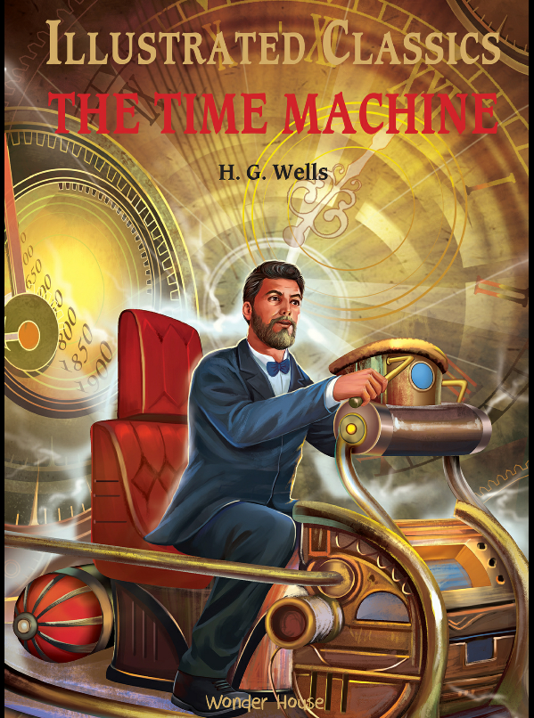
Intralingual Translation
Accessibility
2023

Slide 16
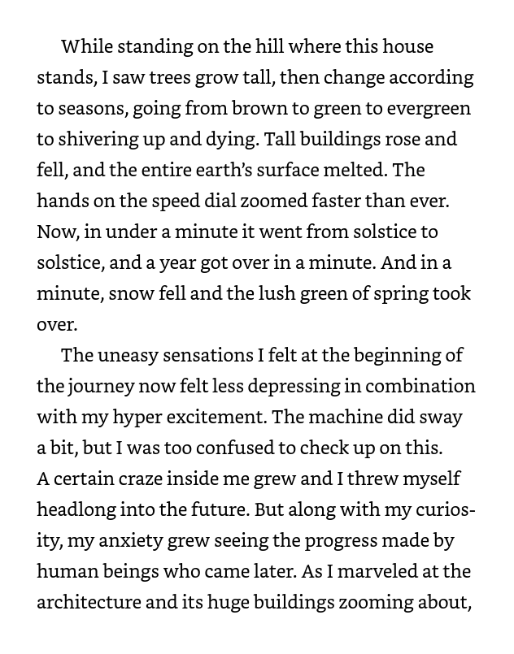
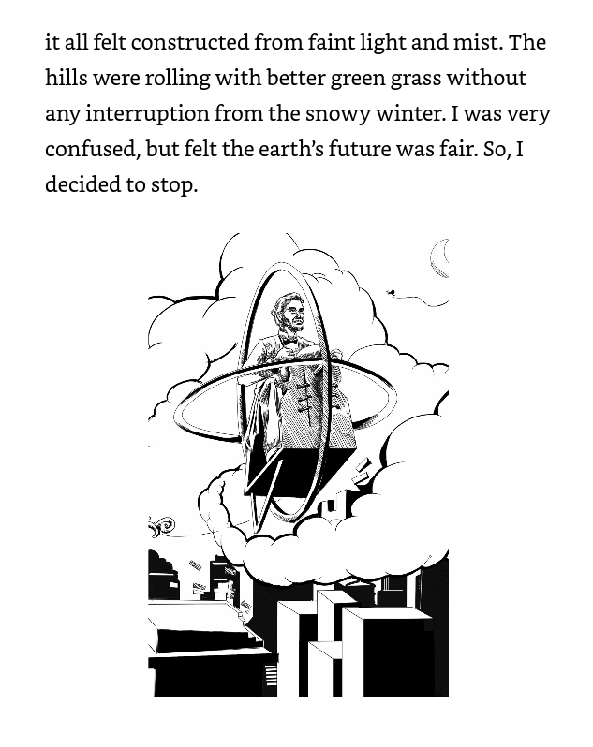

Slide 17
Tymoczo (2007)
The notion of equivalence needs to be reformulated and interpreted as the result of a negotiation between the 'differences' and 'similarities' of the source and target texts and not based on the presence of an invariant core but on the existence of a cluster of resemblances.

Slide 18
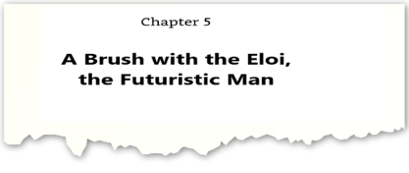
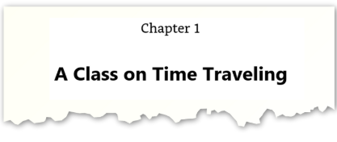

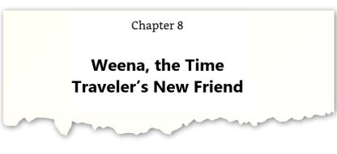
Some chapter titles

Slide 19
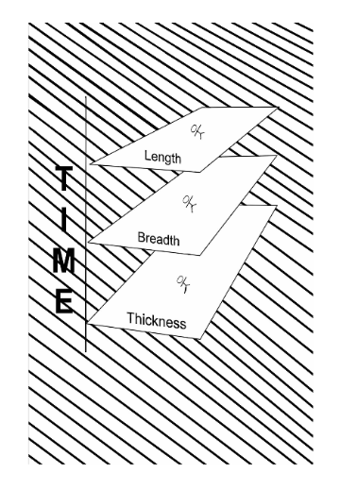
SOURCE TEXT | TARGET TEXT
The Time Traveller (for so it will be convenient to speak of him) was expounding a recondite matter to us […] Our chairs, being his patents, embraced and caressed us rather than submitted to be sat upon, and there was that luxurious after-dinner atmosphere when thought roams gracefully free of the trammels of precision. And he put it to us in this way—marking the points with a lean forefinger— as we sat and lazily admired his earnestness over this new paradox (as we thought it:) and his fecundity. “You must follow me carefully. I shall have to controvert one or two ideas that are almost universally accepted. The geometry, for instance, they taught you at school is founded on a misconception.” “Is not that rather a large thing to expect us to begin upon?” said Filby, an argumentative person with red hair. “I do not mean to ask you to accept anything without reasonable ground for it. You will soon admit as much as I need from you. You know of course that a mathematical line, a line of thickness NIL, has no real existence. They taught you that? Neither has a mathematical plane.” These things are mere abstractions.” “That is all right,” said the Psychologist. “Nor, having only length, breadth, and thickness, can a cube have a real existence.” “There I object,” said Filby. “Of course a solid body may exist. All real things…” “So most people think. But wait a moment. Can an INSTANTANEOUS cube exist?” “Don’t follow you”, said Filby. “Can a cube that does not last for any time at all, have a real existence?” Filby became pensive. “Clearly,” the Time Traveller proceeded, “any real body must have extension in FOUR directions: it must have Length, Breadth, Thickness, and – Duration. But through a natural infirmity of the flesh, which I will explain to you in a moment, we incline to overlook this fact. There are really four dimensions, three which we call the three planes of Space, and a fourth, Time. (Wells, 1995: 4-5)
The Time Traveler was trying to explain a complicated issue to us. […] It was post-dinner and our chairs felt extra soft and comfortable. We […] lazily admired his zest in telling us of his amusing ideas and theories.
“I tell you one or two ideas that the whole world believes in except me. For example, geometry is a misunderstanding. A line of thickness equivalent to zero or even mathematical plane do not exist. Even a cube can't exist with only length, breadth, and mass.” “That I don’t agree with. All real things exist...”, said Filby, a red-haired man with a quarrelsome personality. “A real body will extend in four directions: length, breath, thickness, and duration. Three planes of Space, and the fourth dimension – Time. […]
(Wells, 2023: 8-9).

Slide 20
Intralingual procedures
Disaggregation
Condensation
Omission
Substitution
Shifting
Desubordination
Explicitation
Amplification

Slide 21
The Epilogue: amplifications
The Age of Unpolished Stone | The Age of Unpolished Stone (formerly called Palaeolithic Age, which is Phase one of the Stone Age, when man first began making stone tools).
The Cretaceous Sea | The Cretaceous Sea (that today falls between the Gulf of Mexico and Artic Ocean)
The Triassic Age | The Triassic Age – a period of 50.6 million years that approximately began from the end of the Permian Period, to the start of the Jurassic Period (more than 200 million years)

Slide 22
The relationship between space dimensions and time

Slide 23
Categories of Intralingual Translation
ISOMESIC
the target text maintains the same language mode of the source text
DIAMESIC
the language mode of the target text changes

Slide 24
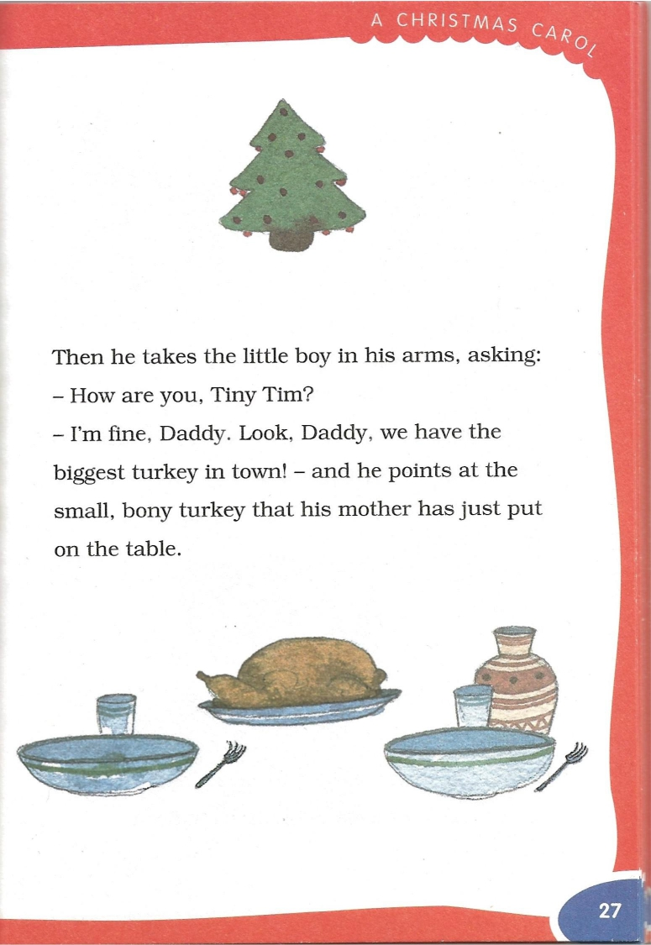
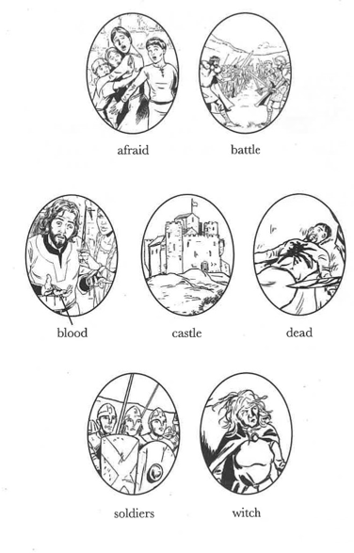
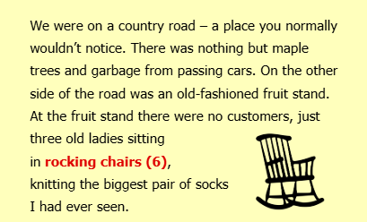
Marginalia, graphic glosses, glossaries and the like

Slide 25
Categories of Intralingual Translation
ISOMESIC
the target text maintains the same language mode of the source text
DIAMESIC
the language mode of the target text changes
ANISOMESIC
Flexible intralingual translation characterised by the addition of other codes.

Slide 26
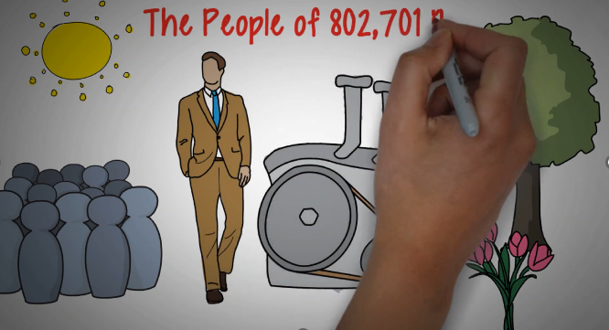
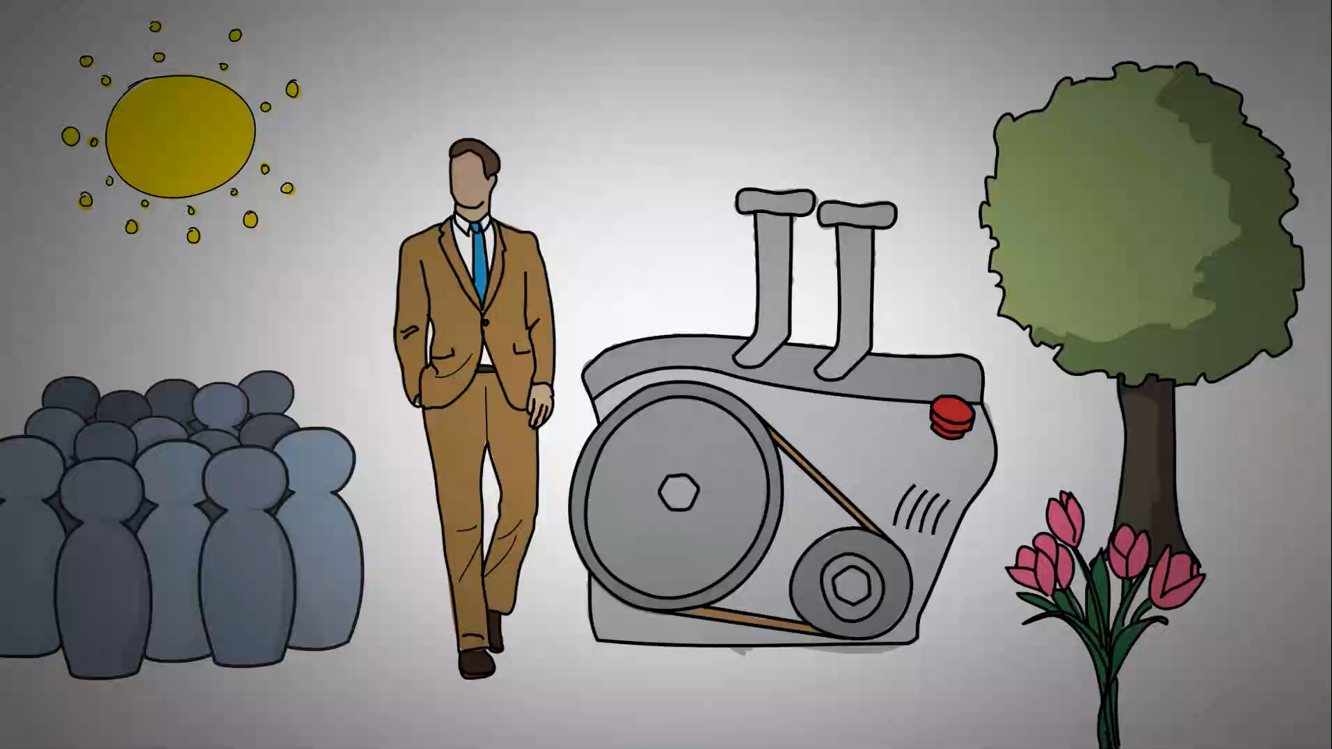
Animated Book Summary

Slide 27
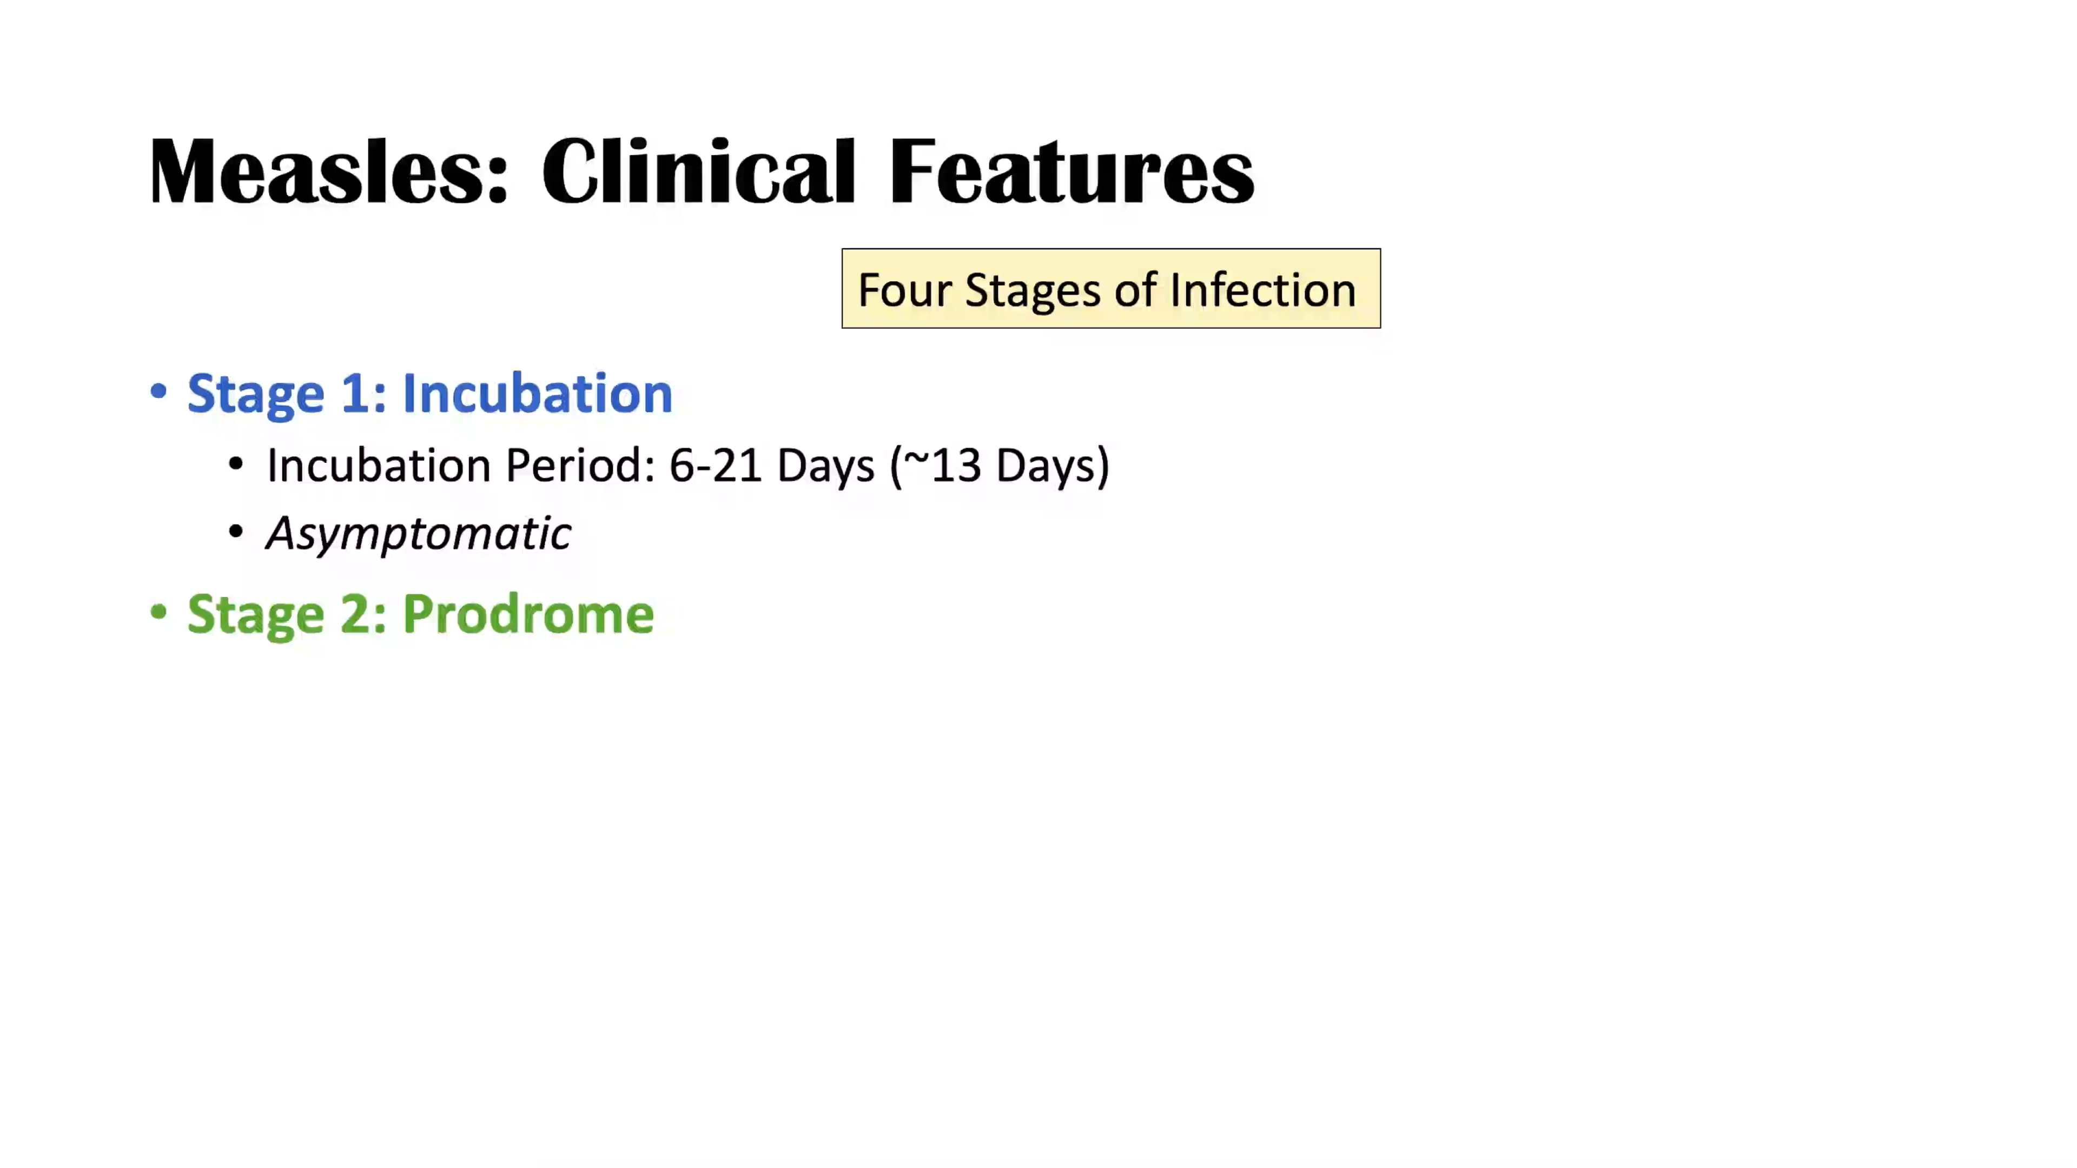
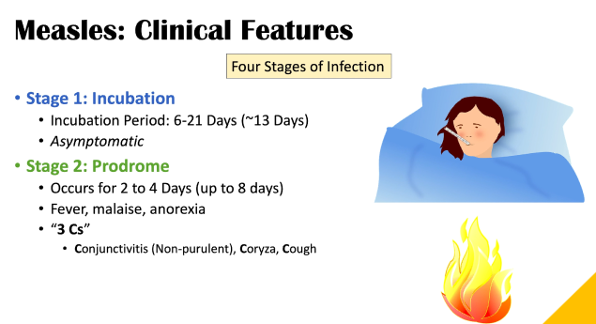
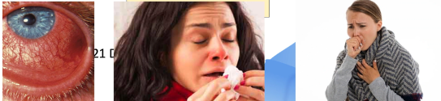
Introduction to measles

Slide 28
Anisomesic intralingual translation
Ultramesic
(more channels)
Inframesic
(less channels)

Slide 29
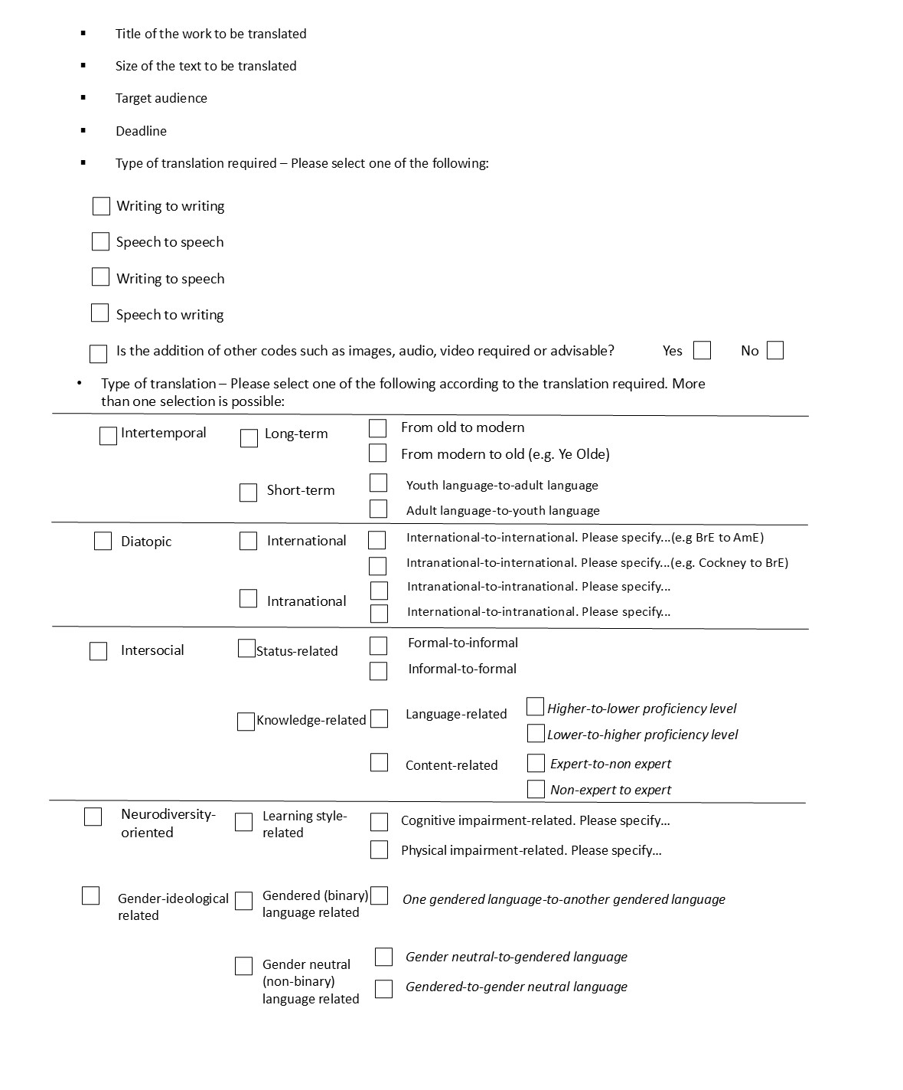
Example of intralingual Translation brief
(Canepari 2024)

Slide 30
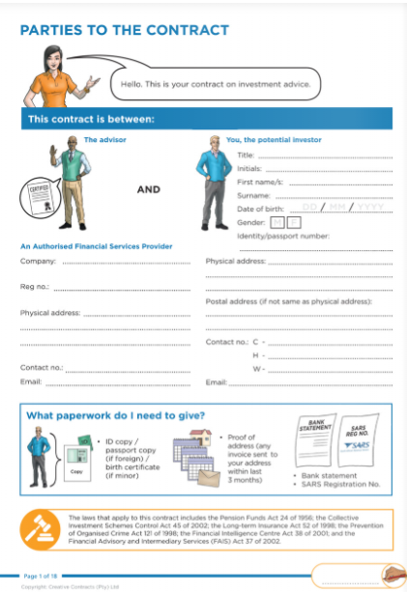
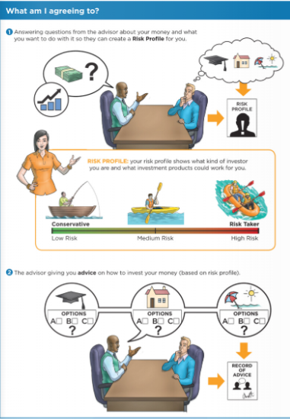
Hybridity in human experience
Contract: Financial Services Provider

Slide 31
Greco (2016)
Accessibility as a human right

Slide 32
Conclusion
Hybrid texts
Hybrid categories

Slide 33

From: A Theory of Adaptation (2006)
“To be second is not to be secondary or inferior; likewise, to be first is not to be originary or authoritative. Yet […] disparaging opinions on adaptation as a secondary mode—belated and therefore derivative—persist. One aim of this book [A Theory of Adaptation] is to challenge that denigration.” (Hutcheon, 2006)

Slide 34
References
Allen, K. & Ingulsrud, J.E. (2003). ‘Manga literacy: popular culture and the reading habits of Japanese college students’, Journal of Adolescent and Adult Literacy 46/8, 674- 83.
Bintz, p., & Ciecierski, L.M. (2017). ‘Hybrid Text: an engaging genre to teach content area material across the curriculum’, The Reading Teacher, 71, 61-69.
British Dyslexia Association (2023). Dyslexia style guide. Retrieved December 30, 2024, from https://tinyurl.com/5fp4av5b.
Byrne, J. (2006). Technical Translation. Usability Strategies for Translating Technical Documentation. Springer.
Canepari, M. (2023). ‘Intralingual and intersemiotic translation for accessibility in educational and social environments – focus on legal language’, Comparative Legilinguistics, 56(4), 147-170.
Canepari, M. (2024). ‘On the theory and practice of intralingual translation and its typologies’, Perspectives 32(6), 1-22..
Canepari, M. (2024). ‘Applying intralingual strategies and procedures to both literary and specialized texts’. In C. Nicolae & A. Pop (Eds). Humanities in the Spotlight. Presa Universitară Clujeană, 85-98.
Clark, R., and Lyons, C. (2011/2004). Graphics for Learning: Proven Guidelines for Planning, Designing, and Evaluating Visuals in Training Materials. Pfeiffer.
Gottlieb, H. (2017). ‘Semiotics and translation’. In K. Malmkjær (Ed.), The Routledge Handbook of translation studies and linguistics. Routledge, 45-63.
Greco, G.M. (2017). ‘On Accessibility as a Human Right, with an Application to Media Accessibility’. In A. Matamala and P. Orero (Eds.), Researching Audio Description. New Approaches. Palgrave, 11-33.
Harrison, B. (1991). Inconvenient Fictions. Yale University Press.
Hasset, D. & Schieble, M. (2007). ‘Finding space and time for the visual in k-12 literacy instruction’, The English Journal 97(1), 62-8.

Slide 35
References
Hutcheon, L.. (2013/2006). A Theory of Adaptation. Routledge.
Jakobson, R.. (2012/1959). ‘On linguistic aspects of translation’. In L. Venuti and M. (Eds), The Translation Studies Reader. Routledge, 126-31
Jüngst, H.E. (2010). Information Comics: Knowledge Transfer in a Popular Format. Peter Lang.
Mannan, B. (2006). Modern Education – Audiovisual Aids. Anmol.
Nord, C. (2008). ‘Defining translation functions: The translation brief as a guideline for the trainee translation’, Ilha do Desterro 33(1) , 41-55.
Rosenblatt, L. M. (1994). ‘The transactional theory of reading and writing’. In R. B. Ruddell, M. R. Ruddell, & H. Singer (Eds.), Theoretical models and processes of reading. International Literacy Association, 1057–1092.
Tymoczko, M. (2007). Enlarging Translation, Empowering Translators. St. Jerome Publishing.
Wells, H.G. (1995/1895). The Time Machine. Dover.
Wells, H.G. (2023/1895). The Time Machine (Classics Illustrated). Translated by Wonderhouse. Wonderhouse.Elster & Hanauer.
Wells, H.G. (2006/1895). The Time Machine (Graphic Novel). Translated by Saddleback. Saddleback.

